Slide 1
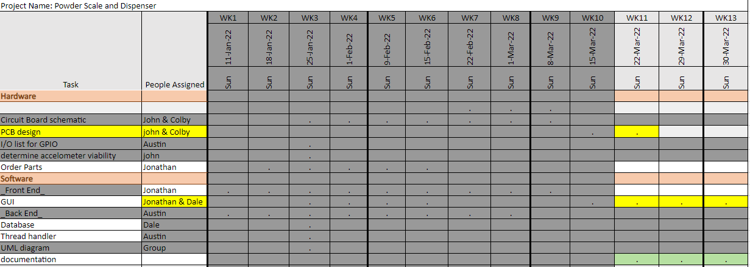
Week 10 (9-Mar to 15-Mar)

Slide 2
Week 10 (9-Mar to 15-Mar) Austin Stecklein
Goal/Task | % Done | Hours (Act.)
debugging running the frontend on the pi | 50 | 2
Creating demo | 75 | 6
Recreating stepper driver | 90 | 6
Hours on task during the week (On track ≥ 13 / wk) | 14
Total hours on task so far this semester (On track ≥ 124 hrs) | 124

Slide 3
Progress made during the week (Log) (What I did)
Imports did not work when moving code from code composer to pi.
Trying to recreate stepper driver (moving forward with calibration idea since it is simpler than the PID model that I created last time)

Slide 4
Difficulties encountered during the week (What I did not do and why)
Code migration

Slide 5
Goals for this coming week (Ones that move the project forward the most)
Goal/Task | Stop Date (Est.) | Hours (Est.)
finish demo with basic operation |  | 4
Basic operation finished and start testing |  | 12
Estimated time needed to work on goals for this coming week (typ. 13 hrs) | 16

Slide 6
Week of 10 Mar to 16 Mar - Dale Andreoli
Goal/Task | % Done | Hours (Act.)
Settings pages – connect to backend: Adjust Feeds, Defaults | 60 | 8
Save page – connect to backend
Create test backend if unable to use development board |  | 3
Confirmation message for Calibrate button | 100 | 2
Project Objective / Mission Statements
Power Scale Dispenser:
Design, build, and test the electronics for the dispenser with a touch screen display and controlling two stepper motors by April 6, 2021 with a prototyping budget of $1000 USD and for less than 600 people-hours.
Hours on task during the week | 13
Total hours on task so far this semester | 122

Slide 7
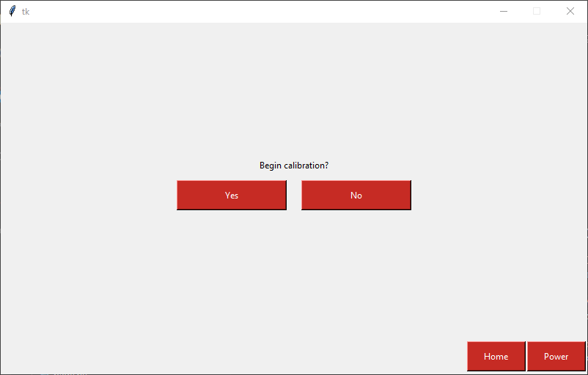
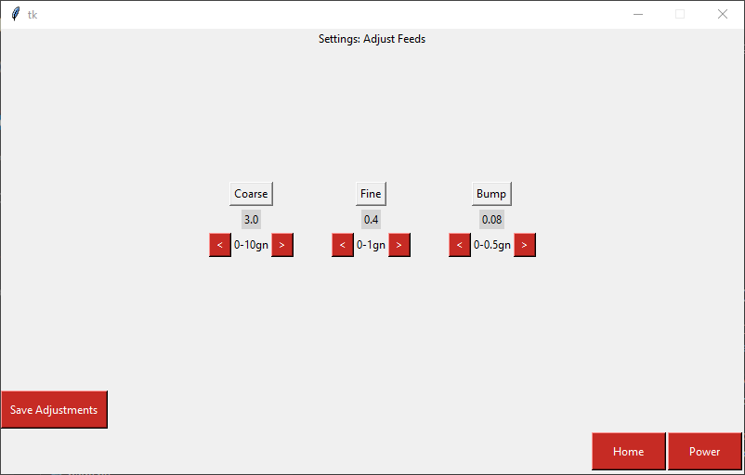
Progress made during the week (Log) (What I did)
Confirmation dialogue for calibrate button Created and connected backend for settings:
Adjust feeds page
Default settings page

Slide 8
Difficulties encountered during the week (What I did not do and why)
Create and connect backend for settings:
Sound/brightness page
Improved test backend

Slide 9
Goals for this coming week (Ones that move the project forward the most)
Goal/Task | Stop Date (Est.) | Hours (Est.)
Settings pages – connect to/create backend: Sound/brightness page | 3/25 | 8
Merge more of my features with Jonathan’s | 3/25 | 2
(if backend is done and working) Begin Documentation: Comments |  | 4
Estimated time needed to work on goals for this coming week | 14

Slide 10
Week 10 (9-Mar to 15-Mar) Jonathan Phillips
Goal/Task | % Done | Hours (Act.)
Front End – Keyboard Refinement and Name
Front End – Unit Choice by User and Number Update | 100 | 5
Front End – Documentation | 13 | 1
Hours on task during the week (On track ≥ 13 / wk) | 15
Total hours on task so far this semester (On track ≥ 124 hrs) | 112

Slide 11
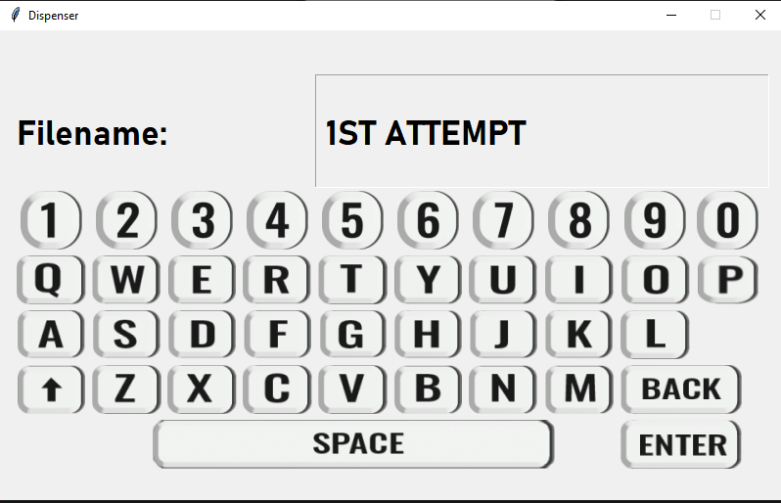
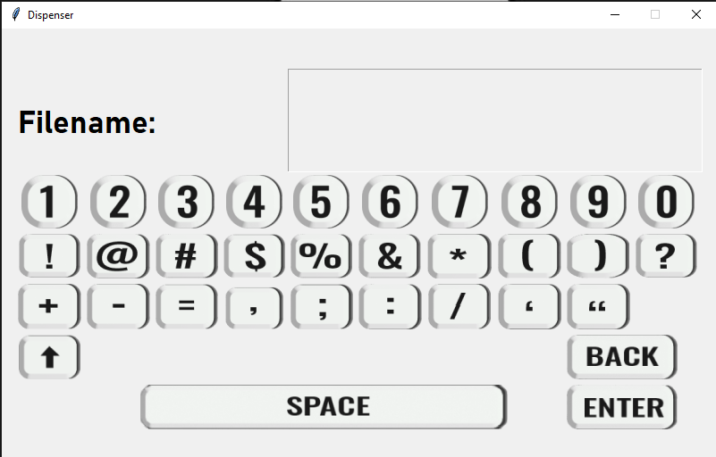
Progress made during the week (Log) (What I did)

Slide 12
Goals for this coming week (Ones that move the project forward the most)
Goal/Task | Stop Date (Est.) | Hours (Est.)
Front end – Visualization of User Inputted Information | 3/23/22 | 4
Front end – General Progression | 4/4/22 | 4
Front end - Documentation | 4/4/22 | 3
Front end - Testing | 4/4/22 | 2
Estimated time needed to work on goals for this coming week (typ. 13 hrs) | 13

Slide 13
Week 10 (9-Mar to 15-Mar) John Stinger
Goal/Task | % Done | Hours (Act.)
Board Development |  | 5
3D Model |  | 2
Board Ordering |  | 3
Hours on task during the week (On track ≥ 13 / wk) | 10
Total hours on task so far this semester (On track ≥ 124 hrs) | 103

Slide 14
Progress made during the week (Log) (What I did)
For example: Resources found (links, manuals), Designs created, Decisions made and corresponding rational, Photos of prototype progress, etc.
The board is done
3D model was generated and sent to Jared

Slide 15
Difficulties encountered during the week (What I did not do and why)
Issues with the KiCad files and JLCPCB

Slide 16
Goals for this coming week (Ones that move the project forward the most)
Goal/Task | Stop Date (Est.) | Hours (Est.)
Start documentation |  | 6
Define the components for JLPCB |  | 6
Estimated time needed to work on goals for this coming week (typ. 13 hrs) | 12

Slide 17
How can we help you achieve your goals?
Continue to support

Slide 18
Week 10 (9-Mar to 15-Mar) Colby Hatton
Goal/Task | % Done | Hours (Act.)
Finish PCB testing, and submit for manufacturing | 90% | ~13
Hours on task during the week (On track ≥ 13 / wk) | 13
Total hours on task so far this semester (On track ≥ 124 hrs)

Slide 19
Progress made during the week (Log) (What I did)
Completed Silkscreen, generated files, uploaded Gerber to JLCPCB

Slide 20
Difficulties encountered during the week (What I did not do and why)
JLCPCB did not like the files. Solved, but late in the week.

Slide 21
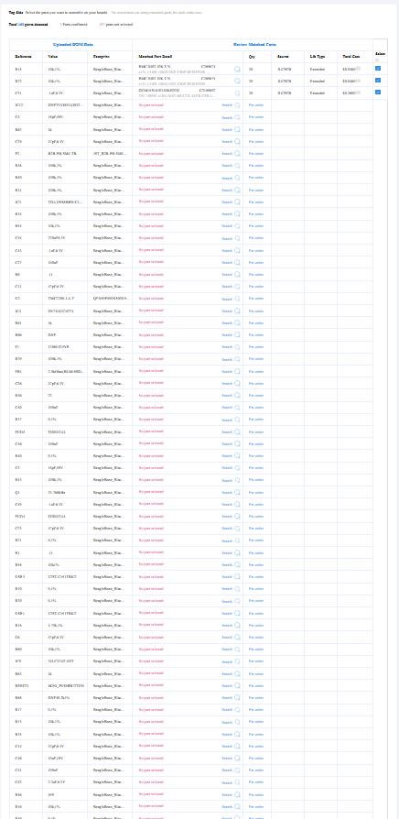

Slide 22
Goals for this coming week (Ones that move the project forward the most)
Goal/Task | Stop Date (Est.) | Hours (Est.)
Spec out list for JLCPCB | 3/18 | 5
Order PCB | 3/18 | 3
Begin Documentation | 4/1 | 5
Estimated time needed to work on goals for this coming week (typ. 13 hrs)

Slide 23
How can we help you achieve your goals?
Innovative solutions to the use of our funding (Let us buy pizza with the budget)

